Slide 1
IFSC Validator
Group members:
1. Vikas Rathod 1603030
2. Kshitij Jagtap 1603036
3. Saurabh Kshirsagar 1603034
4. Ameya Tanavade 1603022
Under the guidance of,
Prof. S.S. Howal

Slide 2
Problem Statement : IFSC Code Validator
Brief:
IFSC code validator is used to check whether entered IFSC code is valid or not.
If the entered code is invalid, then the program asks for account number. And then we generate the IFSC code using the account number.
To perform above task, we are going to use LEX and YACC programming.

Slide 3
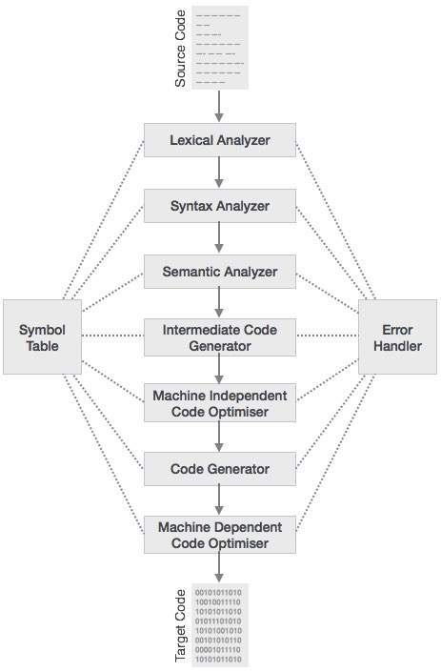

Slide 4
Phases Of Compiler for IFSC Validator
1.Lexical Analysis:
Eg. PUNB 0 392500
<id1,1>= ”PUNB”
<id2,2>= ”id3id4”
<id3,3> = “0”
<id4,4>= ”392500”

Slide 5
2.Syntax & Semantic Analysis:
input
id1 id2
id3 id4

Slide 6
4.Intermediate Code Generator :
t2 = id3id4
t1 = id1t2
input = t1
5.Code Optimization :
t2=id3.id4
t1=id1.t2

Slide 7
Lex Code

Slide 8
%{ int flag=0; char acc[16]; %} ifsc [P][U][N][B][0][a-z A-Z0-9][a-z A-Z0-9][a-z A-Z0-9][a-z A-Z0-9][a-z A-Z0-9][a-z A-Z0-9] cacc [0-9][0-9][0-9][0-9][0][0][0][2][0-9][0-9][0-9][0-9][0-9][0-9][0-9][0-9] sacc [0-9][0-9][0-9][0-9][0][0][0][1][0-9][0-9][0-9][0-9][0-9][0-9][0-9][0-9] acn [0-9][0-9][0-9][0-9][0-9][0-9][0-9][0-9][0-9][0-9][0-9][0-9][0-9][0-9][0-9][0-9] %% {ifsc} {printf("\n IFSC code is valid"); } {sacc} {flag=1;printf("Account number is valid. It is a saving account ");printf("Generated IFSC code is " ); printf("ifsc code is:PUNB0%c%c%c%c%c%c",yytext[0],yytext[1],yytext[2],yytext[3],yytext[4],yytext[5]);}//saving account number. {cacc} {flag=1;printf("Account number is valid. It is a current account ");printf("Generated IFSC code is " ); printf("ifsc code is:PUNB0%c%c%c%c%c%c",yytext[0],yytext[1],yytext[2],yytext[3],yytext[4],yytext[5]);}//current account number. {acn} {flag=1;printf("Enter bank account number to verify ur account.%s \n",yytext); printf("Generated IFSC code is " ); printf("ifsc code is:PUNB0%c%c%c%c%c%c",yytext[0],yytext[1],yytext[2],yytext[3],yytext[4],yytext[5]);} .* {printf("Invalid...! Please Enter valid account number ");} %% void main() { printf("Welcome to punjab national bank"); printf("\n Enter IFSC code"); yylex(); yywrap(); }

Slide 9
Conclusion
We understand the basics of compiler & it’s phases. We came to know about basics of LEX and YACC programs.

